Slide 1
Clustering TRAFFIC data
Technology of 2G

Slide 2
Algorithm
RawData
Data Processing
Determine the optimum k- clusters
Alternative Cluster 1
Alternative Cluster 2
Result:
6 Clusters
Result:
5 Cluster

Slide 3
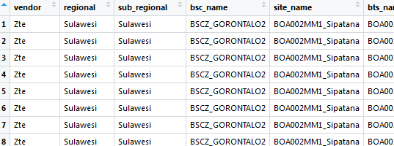
RawData
Using vendor ZTE, 2G
Number of raw 2.127.423

Slide 4
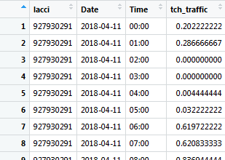
Data Processing
Setting the data as needed

Slide 5
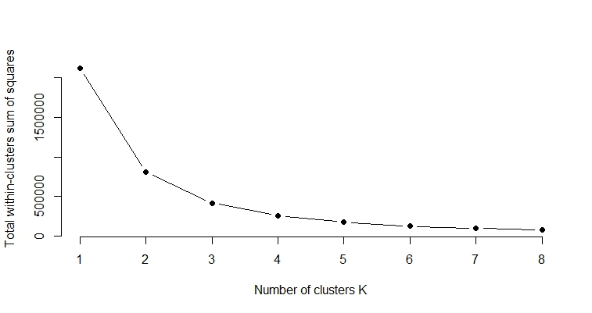
Optimum k-clusters
Using elbow method
Tend to be more stable

Slide 6
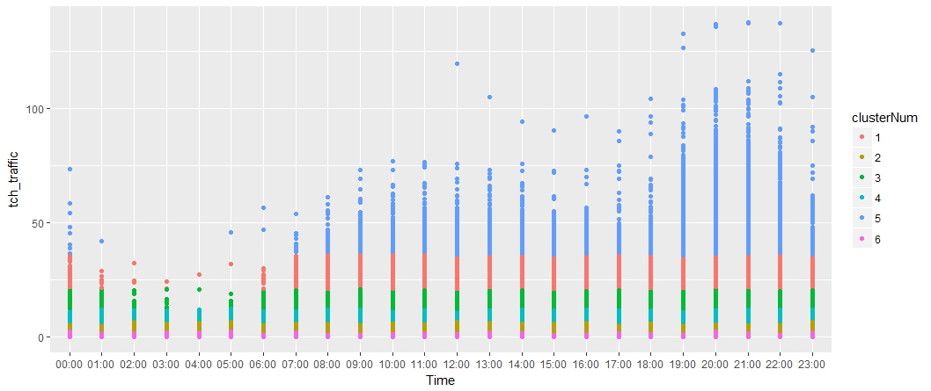
Alternatif Cluster 1 => 6 clusters

Slide 7
Alternatif Cluster 1 => 6 clusters
Within cluster sum of squares by cluster:
Cluster 1 : 19869.48, n= 47492
Cluster 2 : 18790.66, n= 528990
Cluster 3 : 19423.12, n= 131272
Cluster 4 : 19129.66, n= 286229
Cluster 5 : 29622.40, n= 9842
Cluster 6 : 16217.56, n= 1123598
(between_SS / total_SS = 94.2 %)
>> Cluster means : Click to display the data

Slide 8
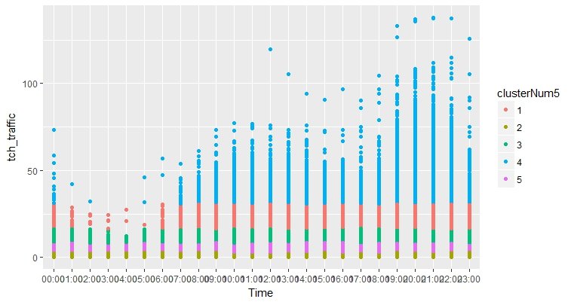
Alternatif Cluster 2 => 5 clusters

Slide 9
Alternatif Cluster 2 => 5 clusters
Within cluster sum of squares by cluster:
Cluster 1 : 32238.68, n= 85475
Cluster 2 : 27371.02, n= 1233486
Cluster 3 : 31882.23, n= 246925
Cluster 4 : 48064.67, n= 17781
Cluster 5 : 31518.69, n= 543756
(between_SS / total_SS = 92.0 %)
>> Cluster means : Click to display the data

